Slide 1

Data Analysis Associate
Accredited by

Slide 2
Bi-variate Analysis

Slide 3
Types of Bivariate Analysis
Continuous-Continuous: Analyzing the relationship between two continuous variables, typically done using correlation or regression analysis.
Categorical-Categorical: Analyzing the association between two categorical variables using techniques like contingency tables or chi-squared tests.
Continuous-Categorical: Examining the impact of a continuous variable on a categorical variable using methods such as t-tests or ANOVA.

Slide 4

Bivariate Analysis: Continuous & Continuous
Some of the common types of bivariate analysis include:
Scatter Plots
Regression Analysis
Correlation Coefficients

Slide 5
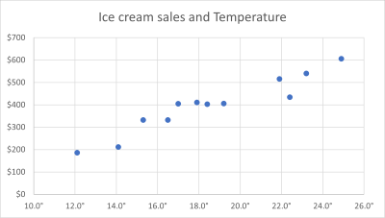
Scatter Plots
Scatterplot provides you with a visual idea of the pattern that your variables follow.

Slide 6
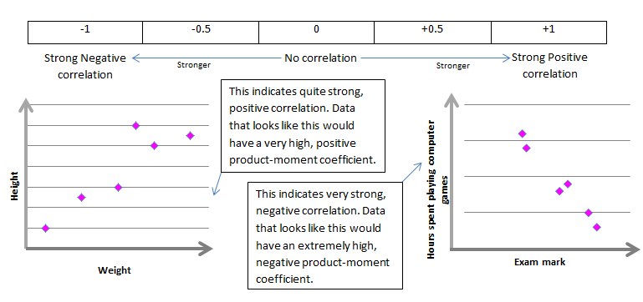
Correlation Coefficients
Calculation of values for correlation coefficients are performed using a computer, although here, you can find the steps to find the correlation coefficient by hand. This coefficient acknowledges you if the variables are related.

Slide 7
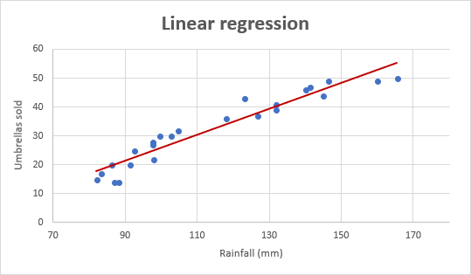
Regression Analysis
Regression analysis is a catch-all term for a wide variety of tools that can be used to determine how your data points might be related. The points in the image above seem like they could follow an exponential curve (as opposed to a straight line).

Slide 8
Bivariate Analysis: Categorical & Continuous
T-Test
Anova Test

Slide 9
T-Test
Determines the impact of a continuous variable on a categorical variable. It is basically used to compare two groups, if they are significantly.

Slide 10
Anova Test
Determines the impact of a continuous variable on a categorical variable. It is basically used to compare more than two groups.

Slide 11
Bivariate Analysis: Categorical & Categorical
Chi-Square Test

Slide 12
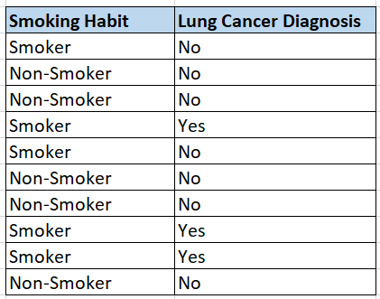
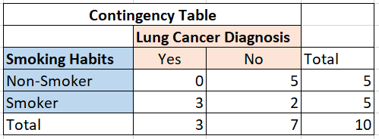
Chi-Square Test
It is used to determine whether the association between two categorical variables is statistically significant or not.

Slide 13
Time Series Data
Time series data is a sequence of data points that measure some variable over ordered period of time. It helps to understand and forecast data patterns. It is important to look for the pattern or components in a Time Series data such as Trend, Seasonality etc.
Examples: Weather Forecasting, Sales Trends, Data captured in CCTV, Stock price, etc

Slide 14
Trend Analysis
Trend is a pattern in data that shows the movement of a series to relatively higher or lower values over a long period of time. In other words, a trend is observed when there is an increasing or decreasing slope in the time series.
Hands-on – Trend Analysis for a Time Series Data.
Line Chart:
Show how a continuous variable changes over time.

Slide 15
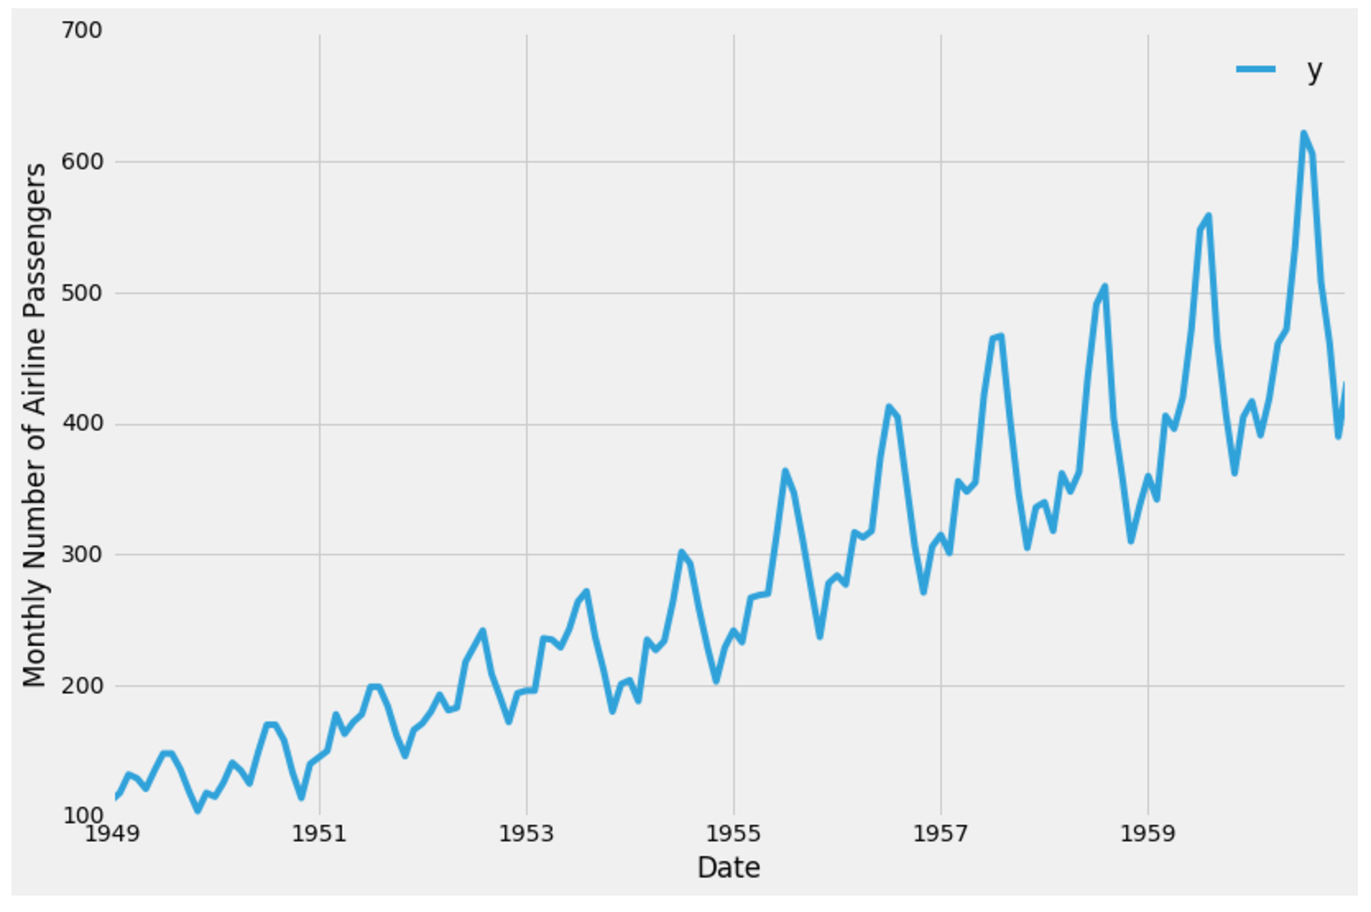
Types of Trend
Upward trend:
Time Series Analysis shows a general pattern that is upward then it is Upward trend.
Downward trend:
Time Series Analysis shows a pattern that is downward then it is Downward trend.
Horizontal or Stationary trend:
If no pattern is observed then it is called a Horizontal or stationary trend.

Slide 16
Comparison Analysis
Comparison analysis involves comparing different variables, groups, or scenarios to identify similarities, differences, patterns, and trends.
Eg. Compare sales and profit across all the regions.

Slide 17
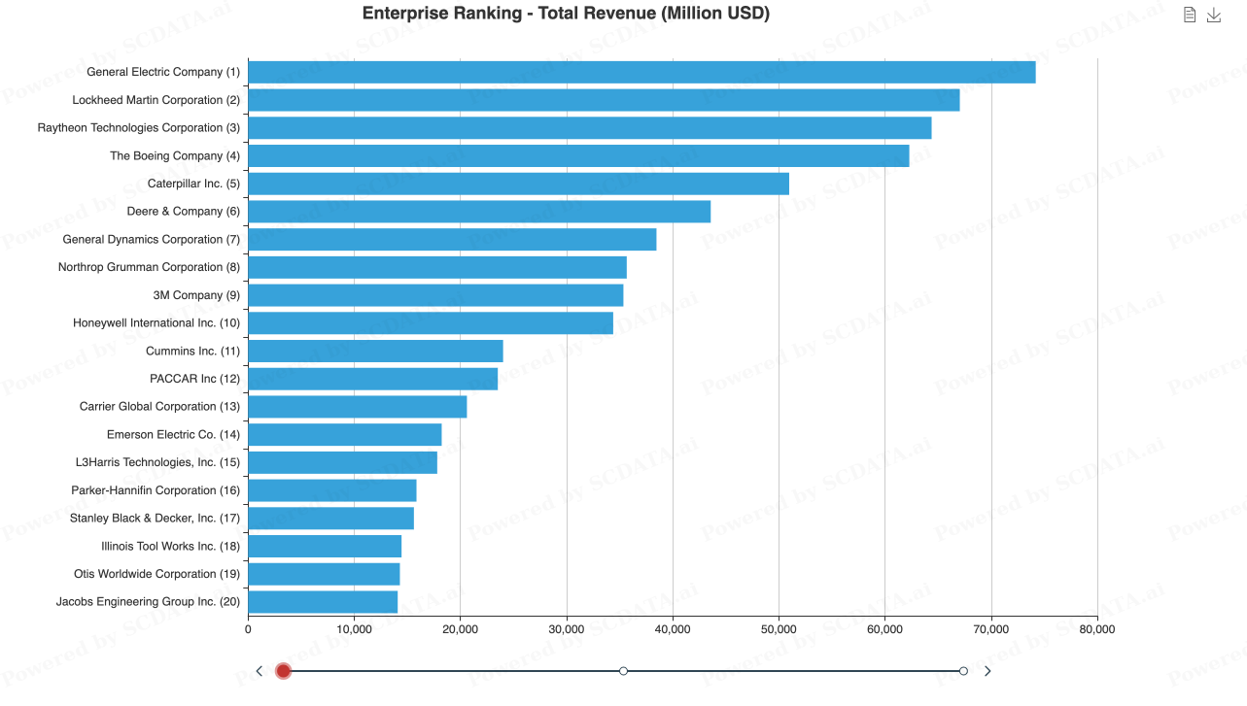
Ranking Analysis
Process of evaluating and analyzing the rankings of items, entities or data, based on certain criteria or attributes.
Eg. Find the top 5 products in terms of Sales.

Slide 18
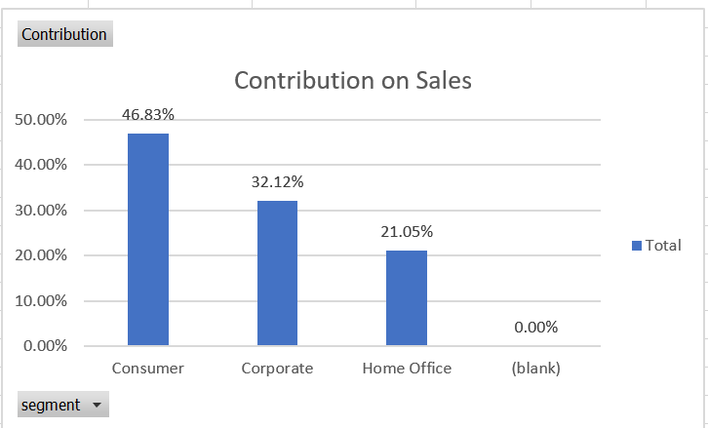
Contribution Analysis
Contribution analysis is a powerful tool that helps businesses and organizations to analyze the contribution of various factors towards a particular outcome.
Eg. Analyze the contribution of categories towards Sales, Revenue, etc

Slide 19
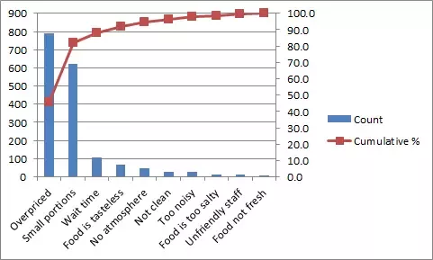
Pareto Analysis
Pareto analysis, also known as the 80/20 rule, is a management tool used to identify the most significant factors or causes that contribute to a particular outcome. In Pareto analysis, it is assumed that 80% of the effects are caused by 20% of the factors.
Restaurant

Slide 20
Also called an 80-20 rule, 80% of the problems are caused by 20% of facts whether if you look into profits, customer complaints, technical issues, product defects, etc.
It statistically separates a limited number of input factors that have a greater impact on an outcome
It is a powerful quality and decision-making tool.
It organizes and displays information to show the relative importance of various problems or causes of problems.

Slide 21
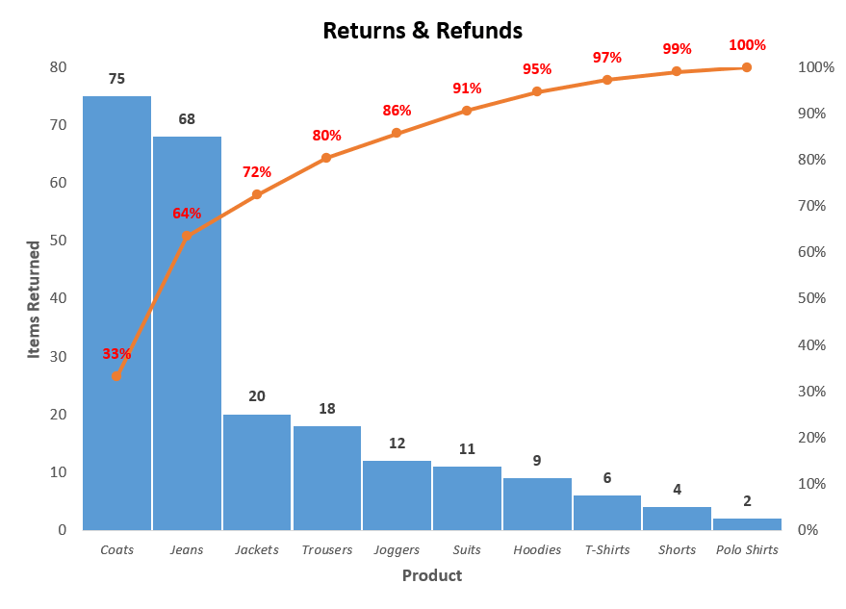
Returns & Refunds

Slide 22
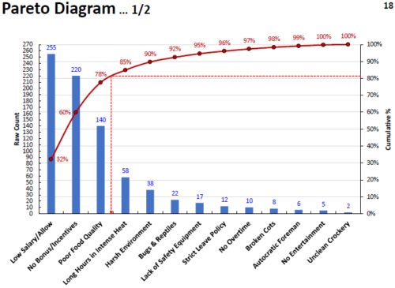
Attrition

Slide 23
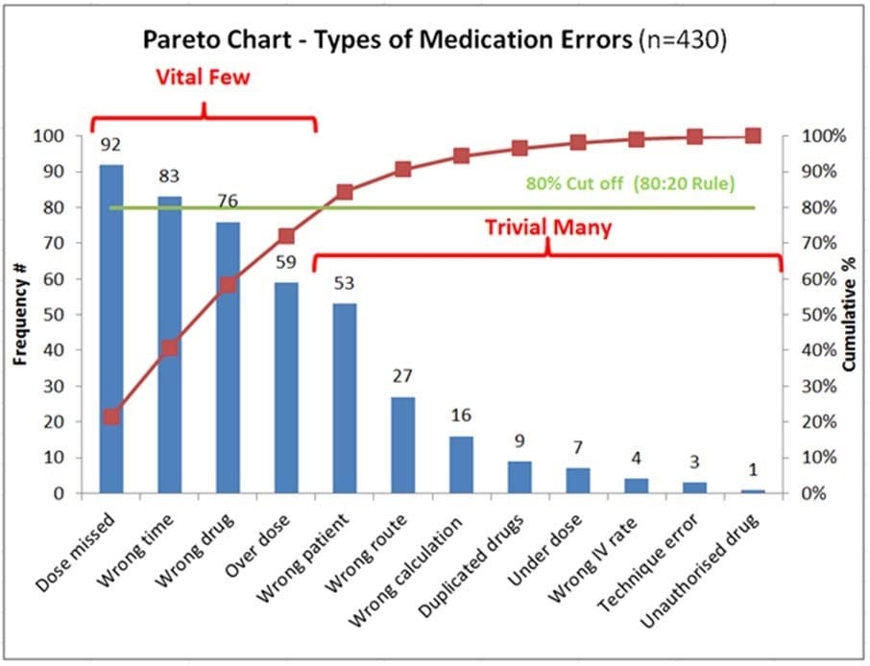
Medication Errors

Slide 24
Interactive Dashboards
Interactive dashboards in Excel are a powerful way to present and analyze data. They allow users to explore and analyze data through interactive charts, tables, and visualizations.
It is a Data Management tool which comes with various interactive features where users can explore the data on a deeper level.
- Prepare your data.
- Create your dashboard with charts, tables or visualizations.
- Add interactivity using slicer, filters, pivot table etc
- Customize your dashboard
With interactivity, you can create a powerful and effective dashboard that will help you make better decisions based on your data.

Slide 25



Refer & Earn
up to ₹ 5,000/- per referral
End of the Module
Contact care@datamites.com for any queries

